Slide 1
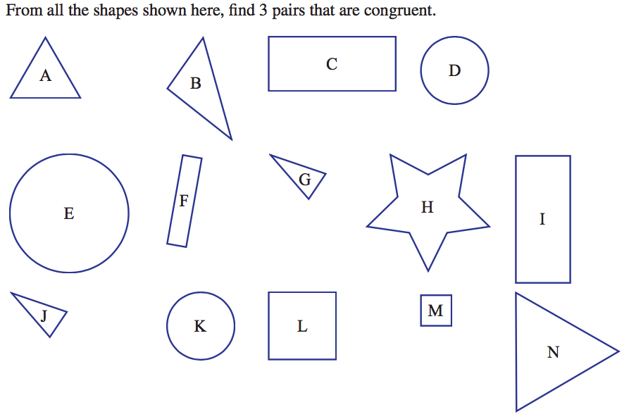
From last lesson:

Slide 2

Now look at the following 2 figures. Are they congruent? Why or Why not? What measurements could you make to check?
Think-Pair-Share
Spend 2 minutes writing down all the reasons you think these two shapes are/are not congruent. Be as specific as possible, using mathematical language
Find a partner and compare your reasons
Share with the class

Slide 3
24
7
30
Date
Congruency in Quadrilaterals and Triangles
EQ – What are the conditions of congruency for quadrilaterals and triangles?
What makes a pair of shapes “congruent”?
Same size and shape
The image of a figure that is reflected, rotated or translated is congruent to the original figure
Corresponding (matching) parts of a figure have the same geometric properties
Summary -

Slide 4
24
7
30
Date
Congruency in Quadrilaterals and Triangles
EQ – What are the conditions of congruency for quadrilaterals and triangles?
In the two triangles below, the conditions for congruency can be expressed like so:
AB ≅ DE
BC ≅ EF
AC ≅ DF
∠ A ≅ ∠ D
∠ B ≅ ∠ E
∠ C ≅ ∠ F
B
A
C
ΔABC ≅ Δ DEF
E
F
D
Summary -

Slide 5
But, do you need all six ?
Let’s Find out !

Slide 6
How much do you
need to know. . .
. . . about two triangles
to prove that they
are congruent?

Slide 7

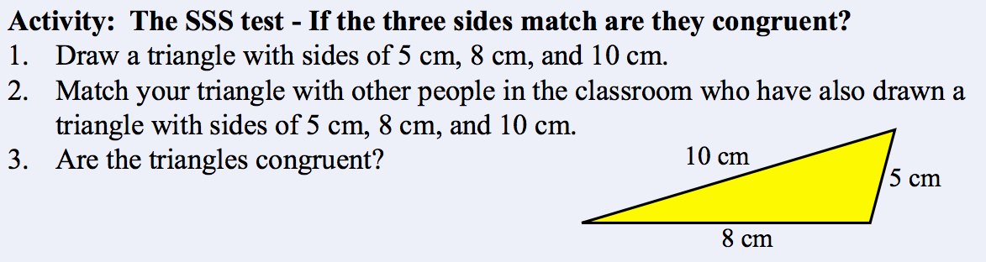
24
7
30
Date
Congruency in Quadrilaterals and Triangles
EQ – What are the conditions of congruency for quadrilaterals and triangles?
Materials: Pen/Pencil, Paper and a Protractor
Test 1:
Summary -

Slide 8
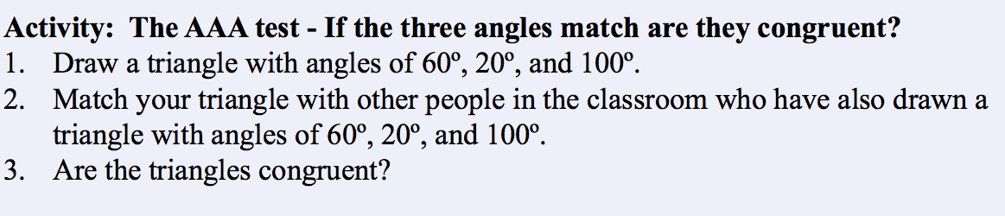
24
7
30
Date
Congruency in Quadrilaterals and Triangles
EQ – What are the conditions of congruency for quadrilaterals and triangles?
Test 2:
Summary -

Slide 9
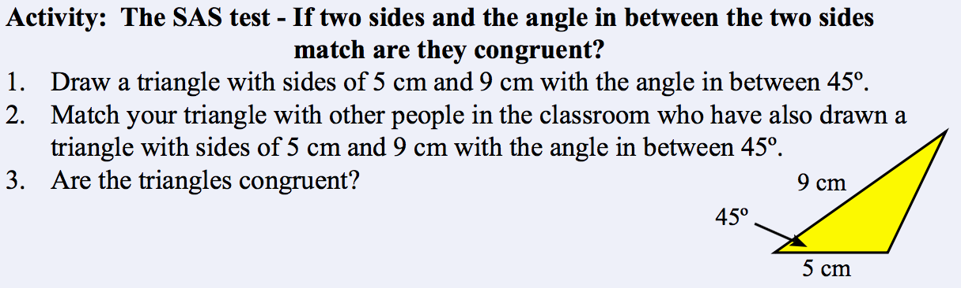
24
7
30
Date
Congruency in Quadrilaterals and Triangles
EQ – What are the conditions of congruency for quadrilaterals and triangles?
Test 3:
Summary -

Slide 10
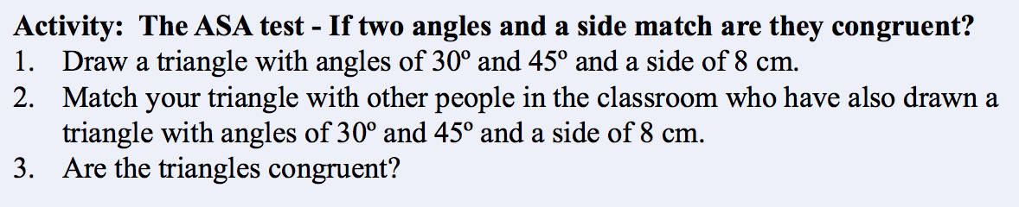
24
7
30
Date
Congruency in Quadrilaterals and Triangles
EQ – What are the conditions of congruency for quadrilaterals and triangles?
Test 4:
Summary -

Slide 11
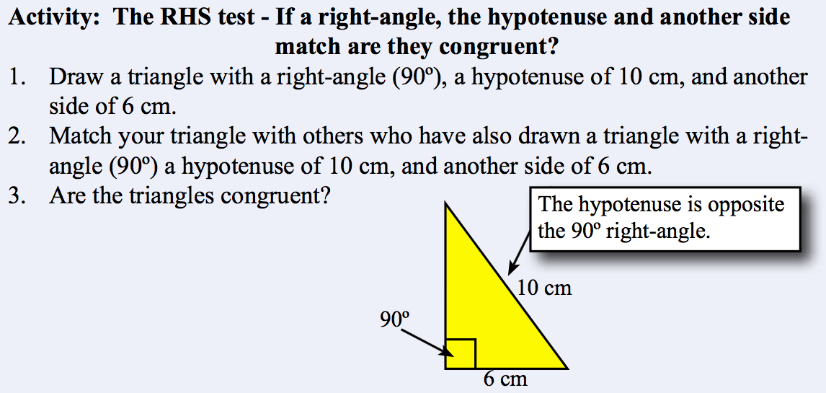
24
7
30
Date
Congruency in Quadrilaterals and Triangles
EQ – What are the conditions of congruency for quadrilaterals and triangles?
Test 5:
Summary -

Slide 12
24
7
30
Date
Congruency in Quadrilaterals and Triangles
EQ – What are the conditions of congruency for quadrilaterals and triangles?
So…what were your findings? Which tests proved to be successful?
Share your findings with the class and summarise them in the Summary section of your INB.
Summary -

Slide 13
